Slide 1
INTO THE TRAIL
Of all the paths you take in life,
make sure a few of them are dirt.
- John Muir
Galen Etie | Edel Farah | Blake Freeman
Trong Nguyen | Ebony Postell

Slide 2
Why a site on hiking trails?
We are born to move. Born to explore.
With a growing active movement in the U.S., we wanted to design a site that would allow adventure seekers in Colorado to gather information on the various hiking trails in that state.

Slide 3
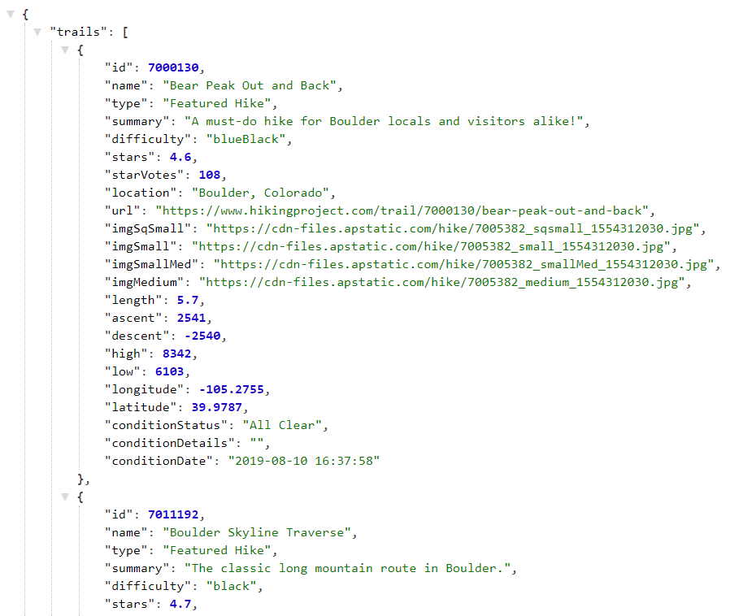
Hiking Project Data API
Source: https://www.hikingproject.com/data

Slide 4
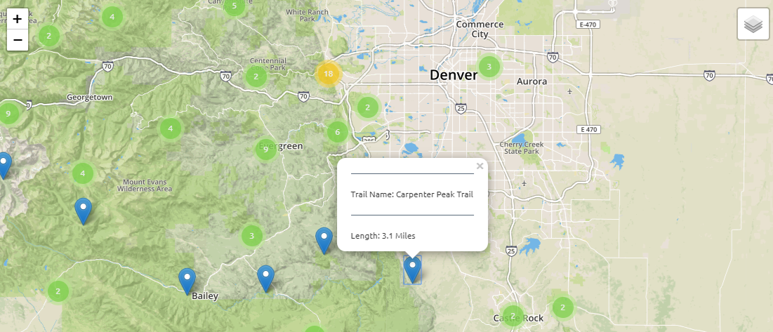
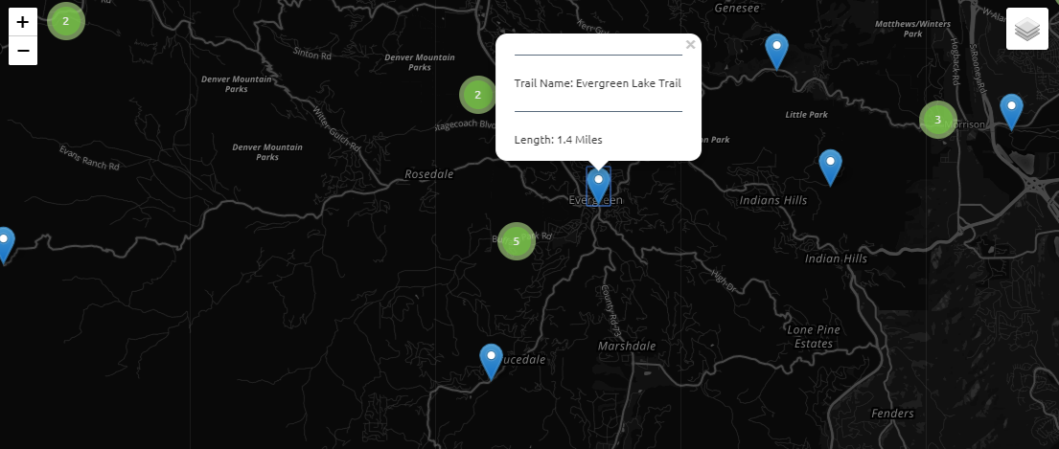
Leaflet JS Library
Source: https://leafletjs.com/
Light View
Dark View

Slide 5

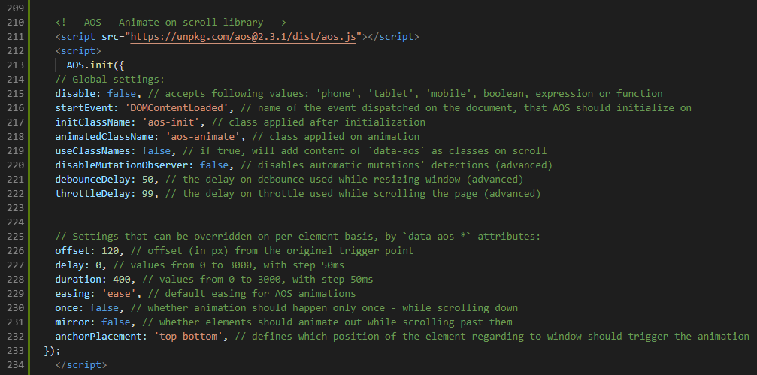
AOS: Animate on Scroll Library
Script: Initialize AOS
CSS: Head of HTML
ASO in Action:

Slide 6
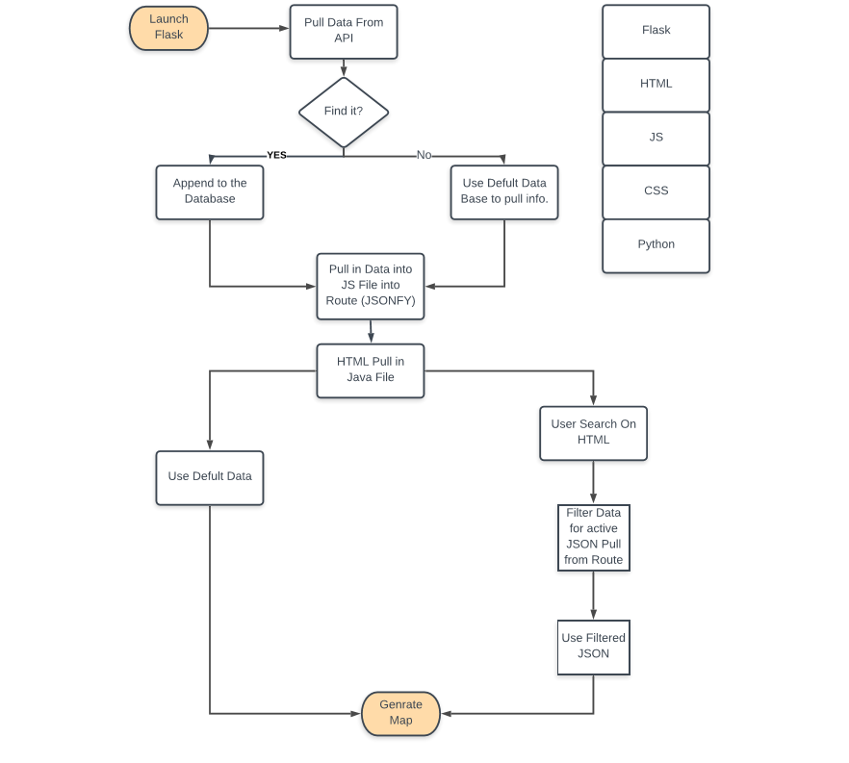
PROCESS

Slide 7
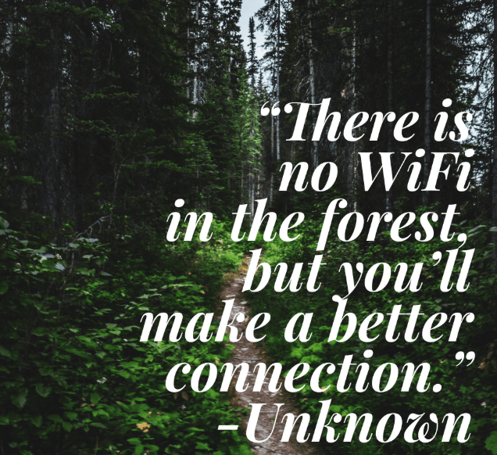
THANK YOU!
Heroku: https://hikingtrail.herokuapp.com/

